Slide 1
Linotype Heater Controls
Digital Replacements
This work is licensed under a Creative Commons Attribution-ShareAlike 4.0 International License.

Slide 2
Overview
General overview of the replacement of Microtherm controls and mechanical relays with digital PID process controller and Solid State Relays.
This is a general guide and basic electrical knowledge is assumed. Most components shown in the following slides can be replaced with other brands and models. It is the reader’s responsibility to verify ratings.
MOST IMPORTANT RULE - GROUND YOUR MACHINE!! THIS IS FOR YOUR SAFETY!
FOR 110V MACHINES - THE NEUTRAL CONDUCTOR IS NOT A SAFETY GROUND, RUN A GROUND WIRE BACK TO YOUR ELECTRICAL PANEL.

Slide 3
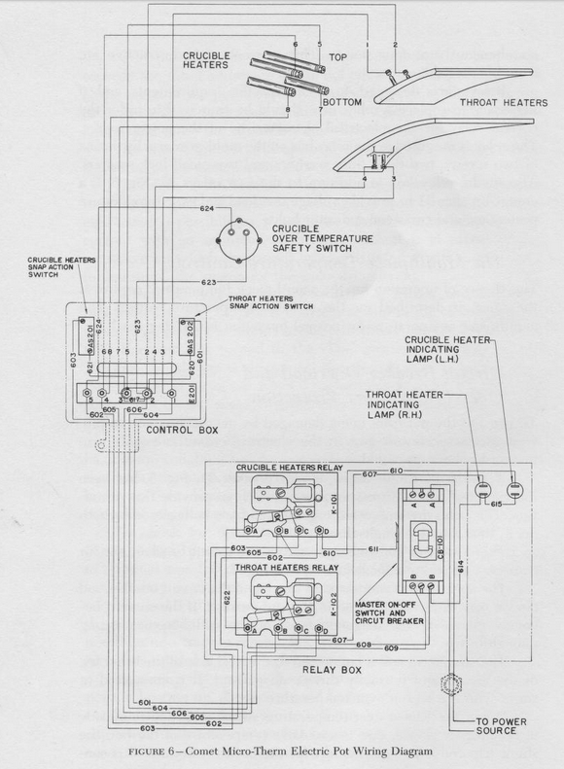
Microtherm Controls
Original microtherm controls use a fluid filled bulb and bellows as a temperature sensor.
Snap-action switches operated the main power relays.
Main relays are mechanical open frame relays.
Over-temperature safety is provided through a bimetal snap action switch made by Klixon. The device is connected to an auxiliary terminal on the master on/off switch which causes the master switch to open if the crucible gets too hot.
Four heaters are used in the system
Two heaters in the crucible
Two heaters attached to the throat
Notes:
What’s a klixon?

Slide 4
Replacement Overview
Individual component functions along with modern replacement part type are listed below:
Fluid-filled Bulbs function as a temperature Sensor, replaced with K-Type Thermocouple
Bellows / Snap Action Switces / Adjustment knobs function as the temperature controller, replaced with PID Controller
Mechanical Relays function as the power switch can be replaced with solid state relays
Klixon bi-metal switch functioned as the overtemperature sensor, these are quite reliable and should be retained.

Slide 5
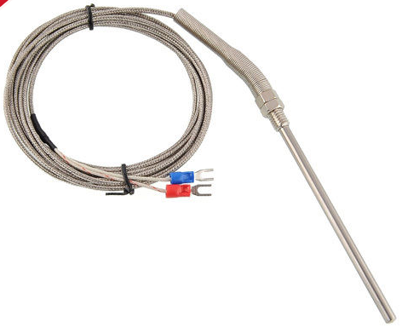
Temperature Sensors
A Stainless Steel clad K-Type Thermocouple can be placed directly in the crucible and mounted in the throat without any difficulty. These thermocouples are typically rated for use from -328 to 2282F, more than enough range for our equipment.
These thermocouples can be purchased through eBay for under $10 each. Search for “Stainless Steel K-Type Thermocouple”

Slide 6
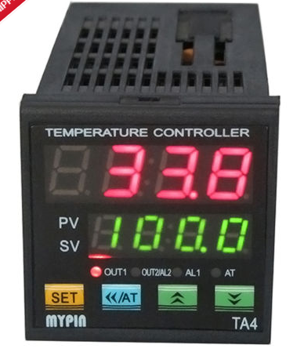
Digital PID Controller
PID Controllers are “Proportional-Integral-Derivative” controllers
These controllers are used frequently in industrial processes
Inexpensive chinese-made units are available on eBay for under $30 each, search for “TA4-SNR”
The SNR model has a main output designed for driving SSRs, No aux output, and a Relay alarm output.
Two PID Controllers are required for Linotype machines, one for the crucible heaters and one for the throat heater.
Notes:
Why SSR outputs? What other alternatives will you commonly encounter?

Slide 7
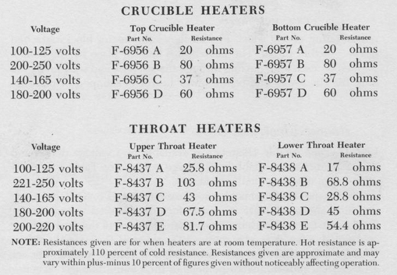
Overcurrent Protection
Circuit breakers or fuses must be used to protect the system from over current conditions.
Individual machine current ratings will vary depending on the heater elements installed in the machine.
It is best if you measure the cold resistance of your heaters to determine the current draw. Current is voltage divided by resistance.
If you have the original heaters and the rating plate is intact you can use the information on the chart in the Microtherm manual:
120V - Crucible: 12A, Throat:12A
100-125V Crucible Heaters
100-125V Throat Heaters
240V - Crucible: 6A, Throat: 6A
200-250V Crucible Heaters
221-250V Throat Heaters
208V - Crucible: 5.2A, Throat: 6.4A
200-250V Crucible Heaters
200-220V Throat Heaters
Notes:
Move the bottom bullet point up by one, and change it to: “It’s best to measure the electrical resistance of your heaters when they’re cold, and use that to figure out the maximum current they can take. Remember, V=IR.” or something like that.
Move the voltage/current bullet and its sub-points to the next slide, re-title the slide something like “Typical max currents for Lino heaters, according to the book” or something like that.

Slide 8
Overcurrent Protection (cont’d)
For most machines the suggested circuit breaker sizes are listed below, but if you have nonstandard elements you will need to determine the appropriate size.
@120V: 30A Main, 25A Crucible, 25A Throat, 1A PID
@240V: 20A Main, 15A Crucible, 15A Throat, 1A PID
@208V: 20A Main, 15A Crucible, 15A Throat, 1A PID
Circuit breakers should be UL489 “branch circuit” listed breakers.
Eaton FAZ-NA series is UL489 listed and is DIN rail mountable.
Notes:
Perhaps add a note like “But remember, it’s better to measure your actual machine than to rely on what the book says it ‘should’ be.”

Slide 9
Overtemperature Protection
Existing crucible klixon can be used in conjunction with a shunt trip for the main input circuit breaker.
Eaton offers a FAZ-XAA-NA110-415VAC shunt trip for the FAZ-NA series of circuit breakers which operates from 110-415V

Slide 10
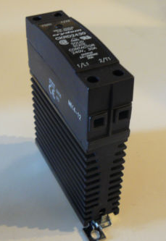
Solid State Relays (SSR)
Any SSR that will accept a +24V control signal will work with the TA4-SNR PID controller
Many different varieties are available from eBay
For a resistive heater a “Zero Cross” SSR is highly recommended.
A "Random" SSR will be more electrically noisy and more prone to burning out the heater elements.
Most high amperage (30A) SSRs will require a heatsink, some will have a built-in heatsink.
An example is the Crydom CKRD2430 (240V 30A)
Notes:
Zero crossing SSR as opposed to what other common types one might encounter?

Slide 11
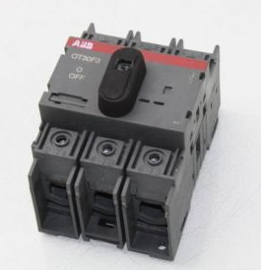
Main switch (disconnect)
A main input disconnect should be installed at the service entrance to the machine
Either a UL98 or UL508 listed disconnect is acceptable
This will function as the power switch
REMEMBER: A circuit breaker is NOT a power switch
Notes:
Add “Either” to the beginning of the second bullet point.

Slide 12
Part costs (as of August 2014)
Breakdown of individual parts cost:
TA4-SNR PID Controller: eBay - 2@ $24/ea
K-Type Thermocouple: eBay - 2@ $7/ea
Crydom CKRD2430 SSR: eBay - 4@ $35/ea
ABB OT30F3 Rotary Disconnect: eBay - $50
30A Double Pole Main Breaker (Eaton FAZ-30/2-NA): Allied Electronics - $80
Main Breaker Shunt Trip (Eaton FAZ-XAA-NA110-415VAC): Allied Electronics - $59
25A Single Pole Heater Breaker (Eaton FAZ-C25/1-NA): Allied Electronics - $36
High Temperature Wire (Omega HTMG-1CU-312S/C 12AWG): Omega Engineering - $3.35/ft
Enclosure: $100
Misc. Hardware: $50
Total: Approximately $550 for all new, reuse of the existing microtherm control main switch is a lower cost option.
Notes:
Give an example of an enclosure?

Slide 13
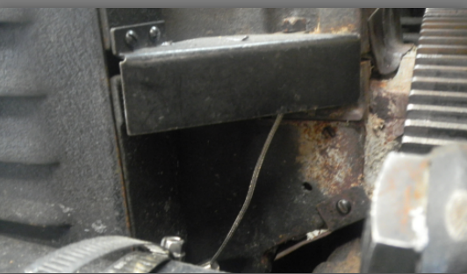
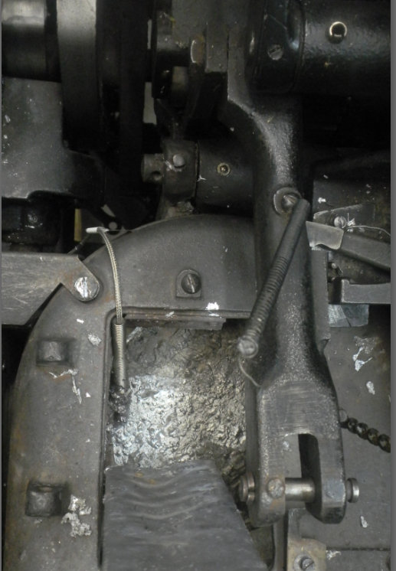
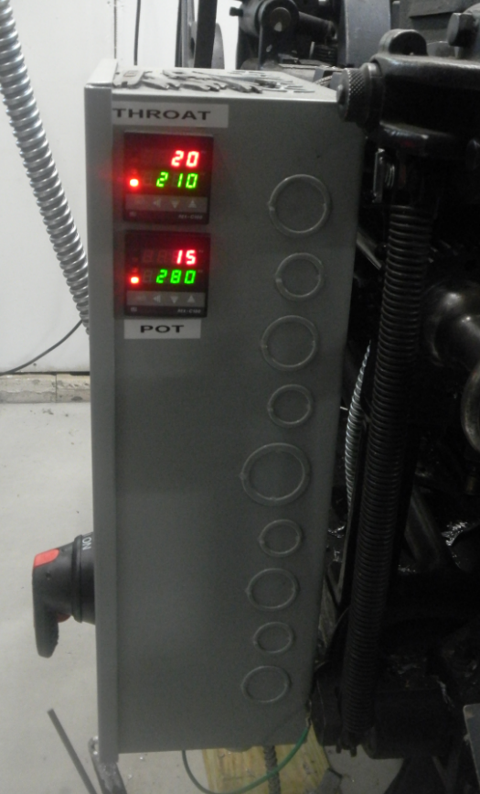
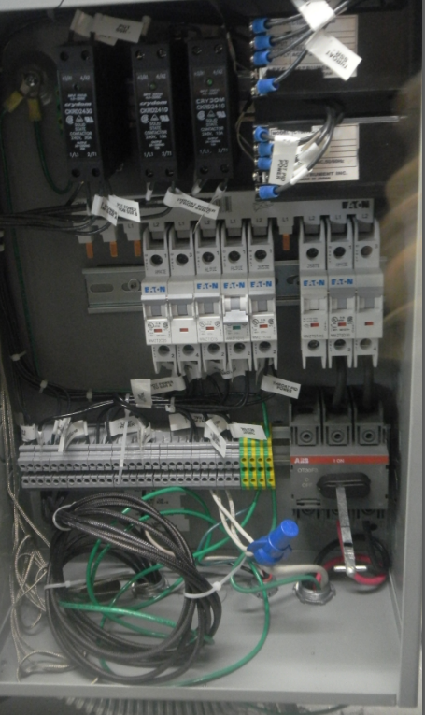
Example Installation
Notes:
PID Controllers in this example are calibrated in degrees celsius.
I didn’t take a good picture of the throat heater prior to putting the machine back together.

Slide 14
Disclaimers
NO WARRANTY. The technical information is provided "AS IS". Mark Turpin makes no warranties or representations, expressed, implied or statutory, including lack of viruses, accuracy, or implied completeness. Mark Turpin disclaims any warranty of title, any implied warranties or merchantability, fitness for a particular purpose, quiet enjoyment, quiet possession, and non-infringement of any third party intellectual property rights with regard to the technical information or the use of those materials.
Limitations and exclusions of damages. In no event shall Mark Turpin be liable for any actual, special, incidental, consequential, or indirect damages, however caused, on any theory of liability and whether or not Mark Turpin has been advised of the possibility of such damages, arising in any way out of the technical information or the use of the technical information.
No engineering services. User is fully responsible for all design decisions and engineering with regard to its products. By providing Technical Information Mark Turpin does not intend to offer or provide engineering services or advice concerning User's design. If User desires engineering services, then User should rely on its retained employees and consultants and/or procure engineering services from a licensed professional engineer ("LPE").
This work is licensed under a Creative Commons Attribution-ShareAlike 4.0 International License.

